Slide 1
Outline
Introduction
I – Project reminder
Flowchart
II – Tests
Neural Network
Data
Results
III – Data transfer reduction
Conclusion

Slide 2
System recap
Our general goal is to reduce broadband usage by existing Mode-S data links
We build a neural network that predicts an aircraft’s position in real time
Runs both on the aircraft and ground stations (ANSP to coordinate all flights), so the ground station can infer the aircraft’s position within a certain margin, instead of getting it though a data link.
Use weather data to make more accurate predictions.
We try federated learning for model training.

Slide 3
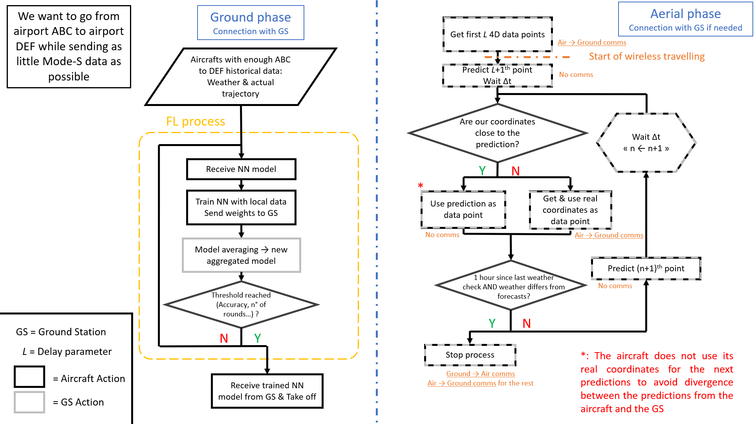
Flowchart

Slide 4
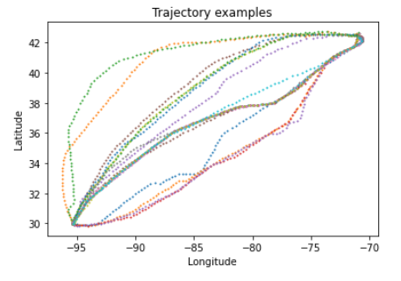
Trajectory data
Set of 169 real trajectories from Houston to Boston airports
Each trajectory contains 80-120 data points under the following format: [Longitude, Latitude, Altitude, Speed]
‘L’ is the « delay » parameter: each trajectory is split into segments of L data points

Slide 5
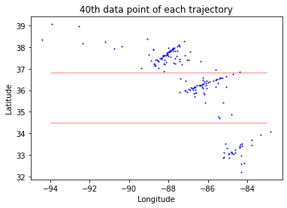
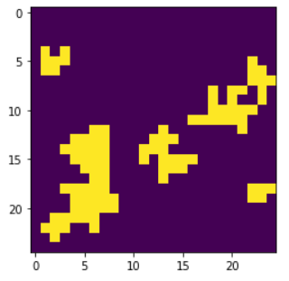
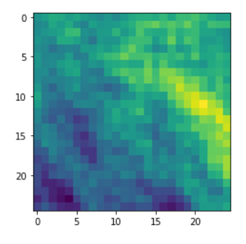
Weather data
Real weather data for a specific timestamp is difficult to find
We randomly generate weather data and expect the neural network to overfit on it
We split trajectories into 3 categories and assign a weather map to each category
Category 1
Category 2
Category 3
Air convective cells
(binary map)
Temperature map
or wind vector coordinates

Slide 6
Neural network architecture
Weather input
Weather input (1x25x25)
Trajectory input (L x 4)
Convolution (3x3)
…
Dropout (2x2)
LSTM (100 hidden)
Encoders
Convolution (3x3)
LSTM (50 hidden)
Dropout (2x2)
LSTM (20 hidden)
Dense (20)
Decoder
Dense (10)
Dense (4)

Slide 7
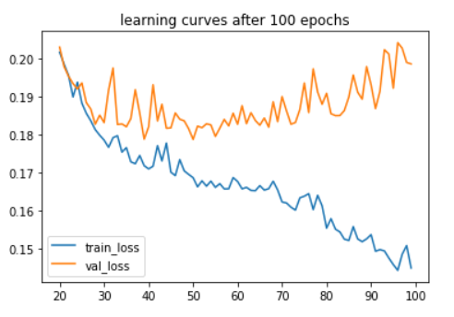
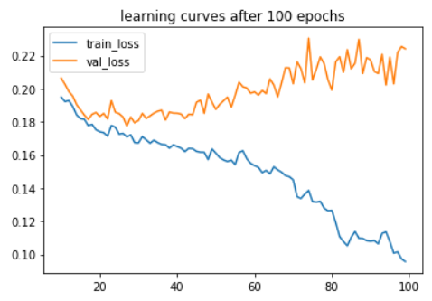
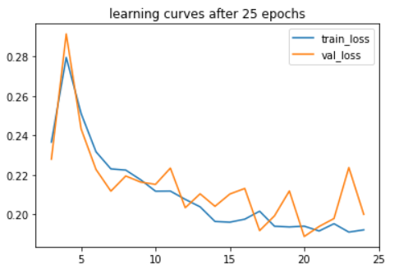
Testing L = 20
10438 training observations
Error function: MSE
100 epochs
1000 batch size
→ 300s training time
100 epochs
500 batch size
→ 320s training time
25 epochs
50 batch size
→ 150s training time
The loss explodes after ~30 epochs

Slide 8
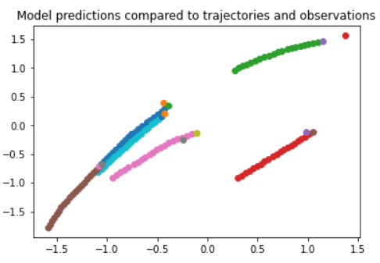
L = 20

Slide 9
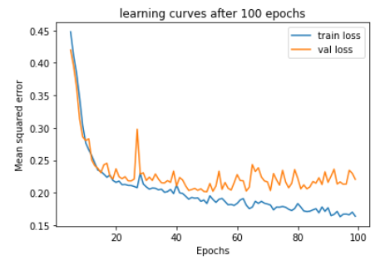
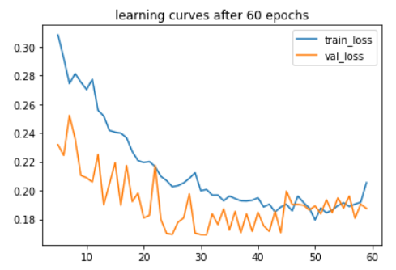
Testing L = 30
9069 training observations
Error function: MSE
100 epochs
500 batch size
→ 370s training time
60 epochs
50 batch size
→ 430s training time

Slide 10
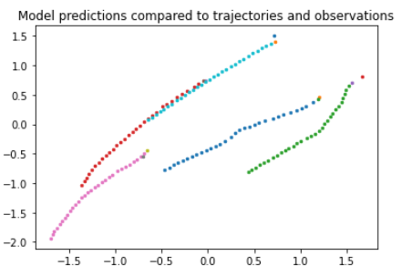
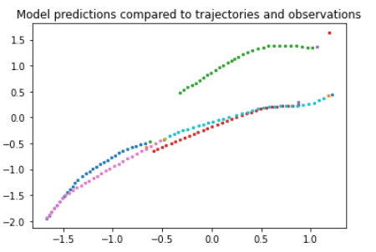
L = 30

Slide 11
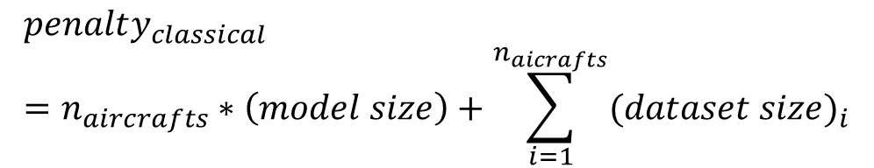
Federated learning
Data divided evenly and randomly among the n aircrafts
The penalty functions correspond to the number of floating-point numbers that would be sent between the aircrafts and the central server over the whole training process
Stopping criterion: Max number of cycles reached
Every cycle, the models of all aircrafts are averaged and sent back to aircrafts
$$penalty_{FL}=n_{cycles}∗2∗n_{aircrafts}∗\left(model size\right)$$
1/n
Aggregated model
1/n
+
$$penalty_{classical}=n_{aircrafts}∗\left(model size\right)+\sum_{i=1}^{n_{aicrafts}}{(dataset size)_{i}}$$
n models
…
1/n
Diagram of a single cycle of FL

Slide 12
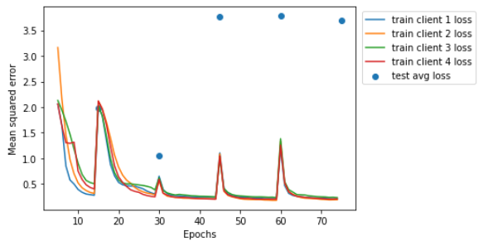
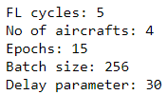
Data transfer reduction
Training phase (fed. learning vs. no fed. learning)
With the current model and the following parameters:
Much worse cost with FL (3x)
Can be improved by reducing the number of model parameters while keeping good predictions, but we need good predictions first.
Flight phase
Predictions are too inaccurate to provide useful value yet.
Most predictions are more than 200 km away from the actual data point
→ The data link must be used systematically

Slide 13
Timeline
Conclusion – Previous interrogations
Feasability of running the NN on board: Commercial airplane computer much weaker than common PCs ; Raspberry Pi’s (drones) can run NNs efficiently
When you say accurate prediction, how much percentage does it improve on the existing paper ? The paper only advances graphical results.
We are using NN to do some data processing on the aircraft, but you say later that we use Federated learning on AC historical data ? The NN is used to predict data points, the pre-processing is done by the program before calling the NN.
How the coordinates prediction is compared ? Are we using historical data or real time ground system for comparison ? If the speed or the distance are above their respective thresholds, we need to send the position to the ground. We are using real time A/C data.
Why the weather check is every 1 hour ? Another parameter to test. Here, the tests are simplified and didn’t use weather forecasts.

Slide 14
Thank you for your attention !

